Slide 1
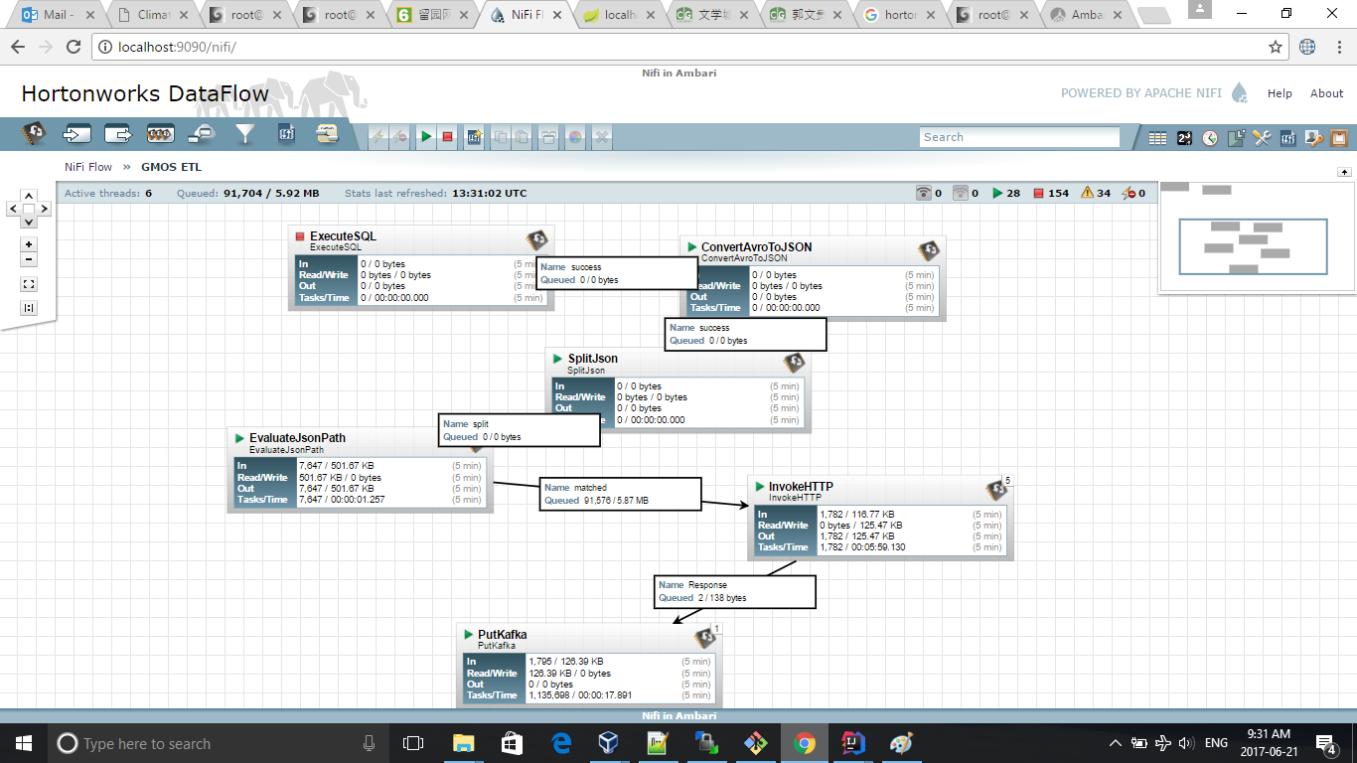
Nifi Workflow

Slide 2
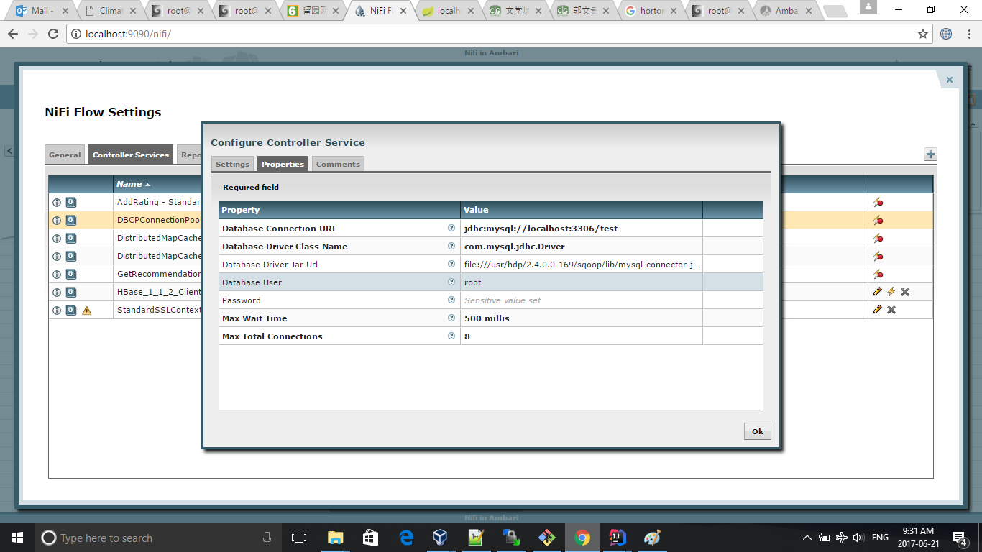
Nifi Data Source Configuration

Slide 3
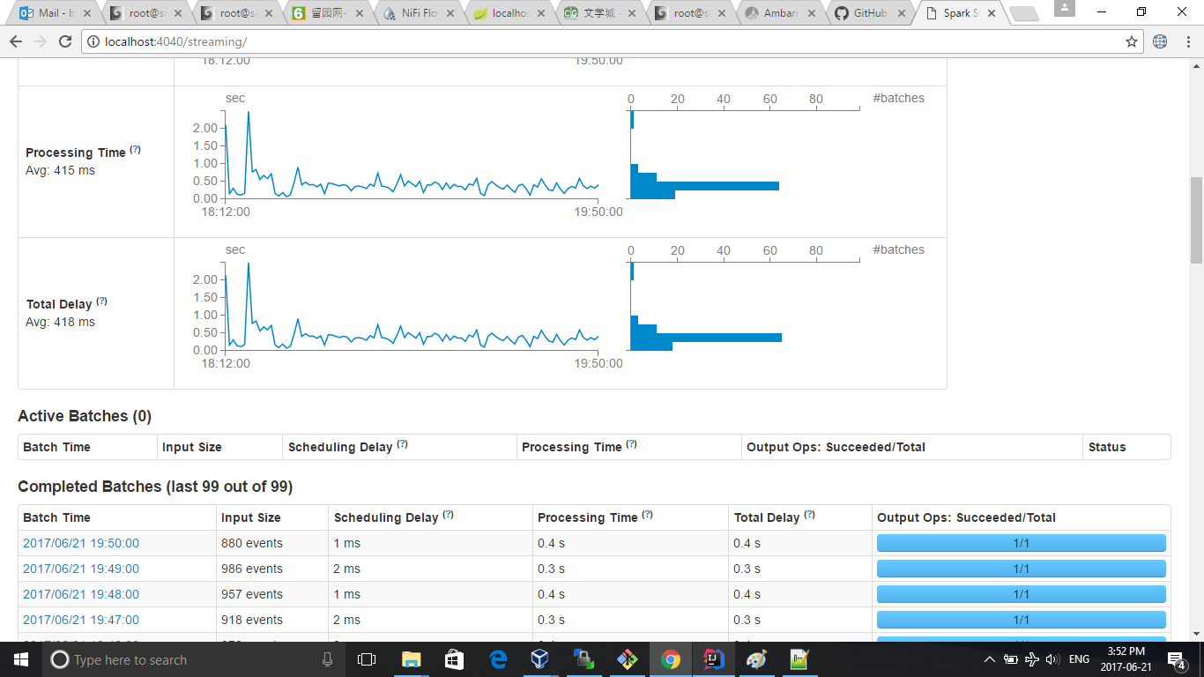
Spark Streaming Monitor

